Slide 1
Columnstore Indexes- باللغة العربية
Ayman El-Ghazali

Slide 2
Agenda
History of Columnstore Index
Architecture and Usage of Columnstore Index
Demo – Columnstore Indexes

Slide 3
History of Columnstore
Introduced in SQL 2012
Non-updatable – to update in a DW environment, partitions had to be implemented
Only Non-Clustered Columnstore index
Updated in SQL 2014
Addition of Updatable Clustered Columnstore index
https://msdn.microsoft.com/en-us/library/dn934994.aspx

Slide 4
History of Columnstore
Ability for Real-time Analytics with SQL 2016
Columnstore indexes have a new capability of being on in-memory tables
Ability to create Non-Clustered Index on Clustered-Columnstore Index
Allows for adding PK constraint to table
Improvements in terms of allowing parallel data insertion in delta-store
Improvement sin performance for string lookups using filtering on dictionary entries
Snapshot and RCSI isolation levels supported
Updateable Columnstore index on Readable Secondary of Availability Group
Updateable Non-Clustered Columnstore index on HoBT
https://msdn.microsoft.com/en-us/library/dn934994.aspx

Slide 5
Columnstore Index Architecture
Data Stored as Rows
Data Stored as Columns
Column1
Column2
Column3
Row 1
C1 | C2 | C3
C1 | C2 | C3
Row 2
C1 | C2 | C3
C1 | C2 | C3
Row Group
Row 3
C1 | C2 | C3
C1 | C2 | C3
Segment

Slide 6
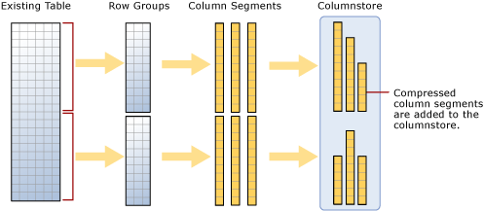
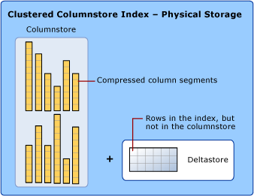
Columnstore Index Architecture
Clustered Columnstore Index
Non-Clustered Columnstore Index on top of existing Table

Slide 7
Columnstore Index Architecture and Usage
Delta store keeps rows until 1 million rows is reached then it becomes part of the compressed data store
Columnstore indexes improve performance of read operations due to the fact that columns are compressed
Ideal for Datawarehouse workloads
Usually involving large scale aggregation
Usually involving few tables, large dataset being brought back

Slide 8
Demo
Columnstore Indexes

